Slide 1

Applications of Multilayer Perceptrons in Engineering

Slide 2
NN Applications
ALVINN
Glove Talk
NetTalk

Slide 3
Autonomous Land Vehicle in a Neural Network (ALVINN)
Ref: Dean Pomerleau, "ALVINN: An Autonomous Land Vehicle In a Neural Network," Advances in Neural Information Processing Systems 1, 1989.

Slide 4
A very old Driverless car
Steering angle
ALVINN
(MLP)
Camera view

Slide 5
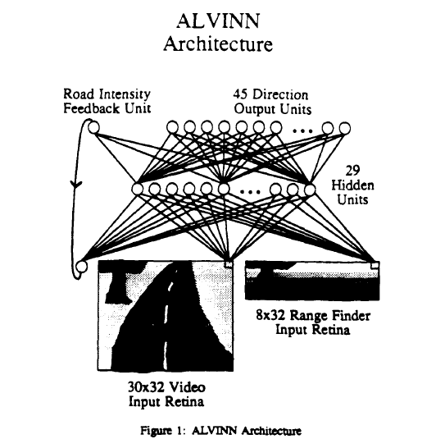

Slide 6
Population coding
y_{i} are
the outputs
of the neurons
y_{i}
u_{i}

Slide 7
Simulated road parameters
Variety of retinal image orientation and position
Variety of lighting conditions
Different road types
Realistic noise added
1200 images created

Slide 8
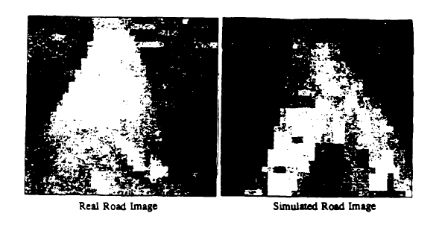

Slide 9
Training from snapshots
1200 synthesized images
Backpropagation algo
40 epochs
Within 2 neurons of the correct answer 90% of the time

Slide 10
Testing while “driving”
NN “drives” down the simulator
Can drive at constant speed for several miles without getting off the road

Slide 11
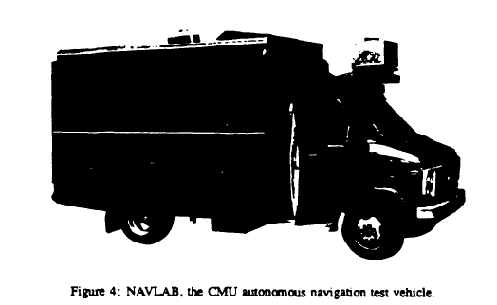
Testing on real roads
400 m stretch of road in CMU campus
Speed = 0.5 m/s = 1.8 kmph
(ridiculously low - “preliminary results”!)

Slide 12
Understanding hidden neurons
y
w
x
y=g(w.x – b)
For normalized x, y is the highest when x and w are parallel

Slide 13
This hidden neuron responds to roads
with one of TWO different orientations

Slide 14
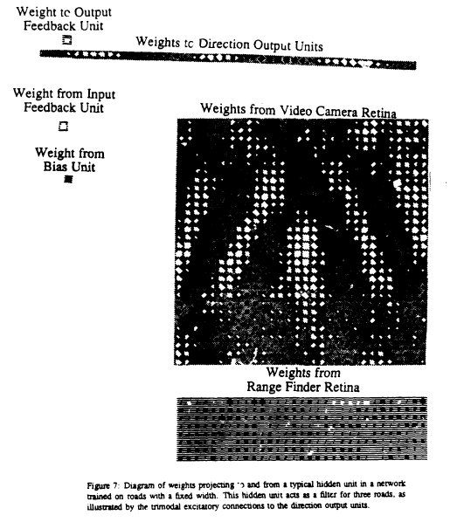
Hidden neuron – weights
Single width roads
Triple road representation
This hidden neuron
responds to roads
with one of THREE
different orientations

Slide 15
NN approach - advantages
½ hr of NN training on the simulator resulted in a road-following system
Months of effort by the research team was required with traditional image processing and computer vision approach
Natural way of fusing different kinds of sensors
Range finder is not very useful for road following but essential for obstacle avoidance
Range finder is expected to be useful in off-road conditions

Slide 16
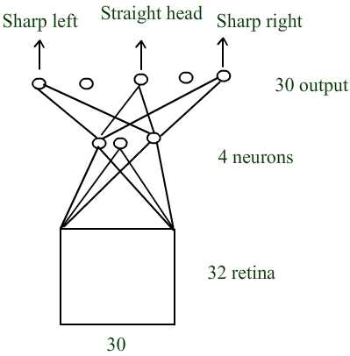
Next version (Pomerleau 1991, 1993)
Training
¼ to ½ of mile of training road which takes about 2 minutes to cover.
50 real images
Transformed 15 times to create 750 images.

Slide 17
Generalization
Generalized to new points of the road
Different weather & lightning conditions
Specialization: Separate networks are trained on:
Single-lane dirt & paired roads
Two-lane suburban roads/city, streets
multilane divided (90 mph) highways

Slide 18
Hidden layer Analysis
Unlined paved roads → “edge detectors” trapezoidal shaped road regions
Lined highways → detectors for line markings
Dirt roads → ‘rut’ detectors.

Slide 19
Testing
Drive up to speeds of 55 mph
Can process upto 10 frames/sec
On a highway ALVINN was able to drive upto 90 miles without human intervention

Slide 20


Glove Talk
Convert hand gestures to speech sounds
ANN

Slide 21
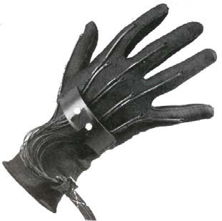
Glove
VPL Dataglove
Two sensors on each finger – measure finger flex angles
“Polhemus” sensor at the back of the hand – measures x,y,z, pitch, yaw and roll
VPL Data Glove

Slide 22
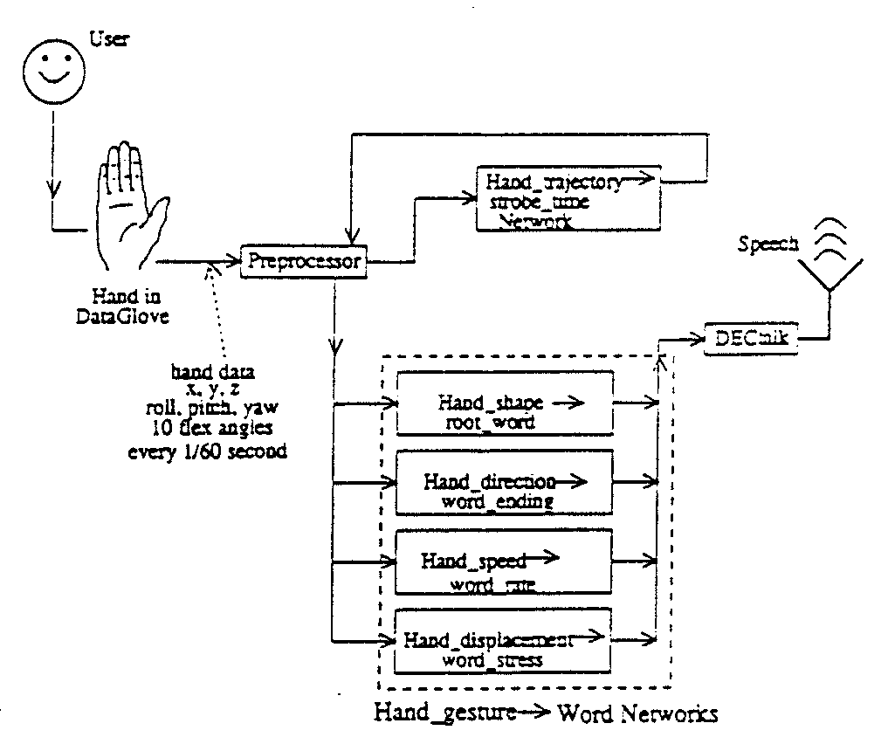
(Fels and Hinton, 1992)

Slide 23
Strobe time network
Indicates end of a word
Input: window of 10 time steps (167 ms) with 5 params
Parameters: Δx, Δy, Δz, norm(Δs), acceleration
Network output: 1 at the point of transition, 0 otherwise
596 hand movements, 27,907 time steps (manually labelled)
If the network is too sensitive: extraneous words are produced
If too insensitive: words or sounds are omitted
Gives 97% hit rate with a tolerance of 3 steps on either side

Slide 24
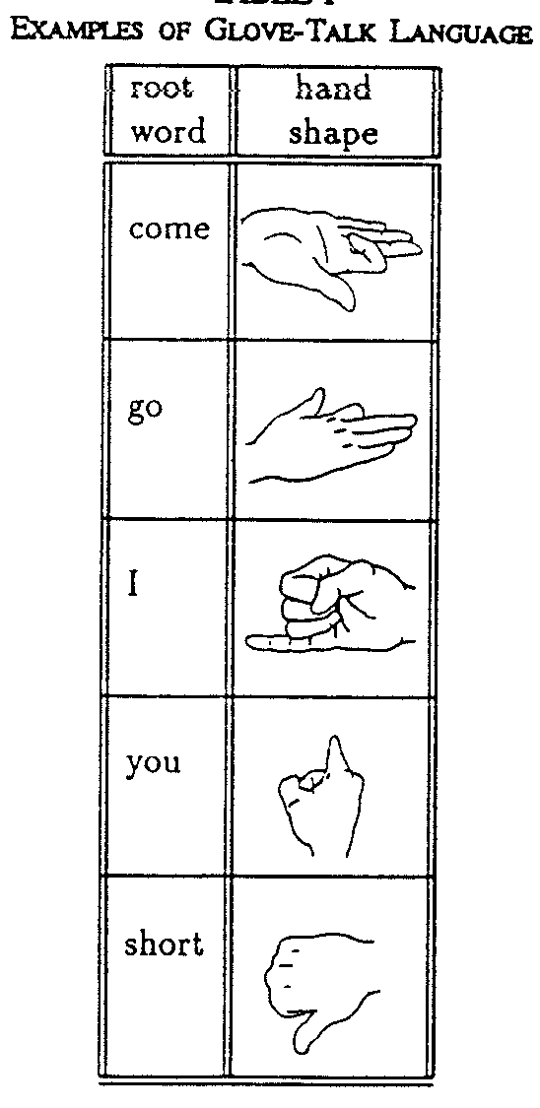
Hand Shape Network
Hand-shape codes for
Root word

Slide 25
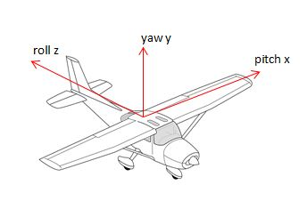
Hand shape network
Codes for root words
Input: 16 params - 2 flex angles from each finger, sines and cosines of pitch, yaw and roll
60 root words
80 hidden neurons

Slide 26
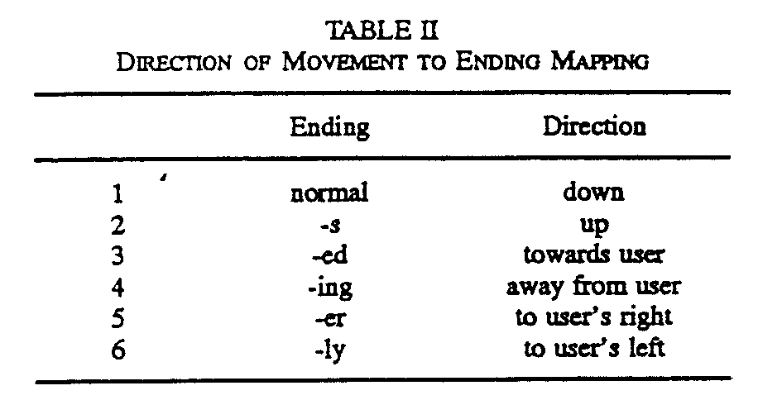
Direction of movement codes for word ending

Slide 27
Word Ending network
30-10-6 mlp
10 time step window, Δx, Δy, Δz, (up to strobe time)
Higher errors with shorter windows
Training – 199 samples; testing – 499 samples

Slide 28
Word Rate network
Word rate based on hand speed
40-15-8 mlp
20 time-step window of hand speed and acceleration (magnitude)
8 output neurons code for speaking rates of 130-340 words per min

Slide 29
Stress network
Word stress based on displacement
40-5-1 mlp
Same input as rate network
Single output: 1= stressed, 0=unstressed.

Slide 30
Results
66 root words, 203 words
1% error
Listen to the system recite Dr. Seuss’ poems!

Slide 31
NetTalk: A neural network that can read text aloud
Ref: Sejnowski, TJ Rosenberg, CR (1986). NETtalk: A parallel network that learns to read aloud, Tech. Rep. No. JHU/EECS-86/Q1

Slide 32
Nettalk is a system that can read English text aloud and can pronounce letters accurately based on context (Sejnowski and Rosenberg 1986).
Background:
English is not a phonetic language.
Char → Sound mapping is not unique (different depending on context).
The character ‘c’ is pronounced as /k/ in “cat” and as /s/ in “façade.”
The letters “-ave” form a long vowel in “gave” and “brave” but not in “have.”
Similarly, the letters “-ea-“ are pronounced as /ii/ (long vowel) in “read” (present tense) (pronounced as “reed”) and as /i/ (short vowel) as in “read” (past tense) (pronounced as “red”).

Slide 33
Network
It uses a three layer MLP.
Input representation:
26 alphabets and three punctuation marks (comma, fullstop and blank space) are supported
Each character is presented along with a context which consists of three additional characters on either side of the character.
Thus text is presented as windows of 7 symbols
Hence, (26 + 3) * 7 input neurons
Hidden layer : 80 hidden neurons
And Output neurons: 26 (encoding phonemes)

Slide 34
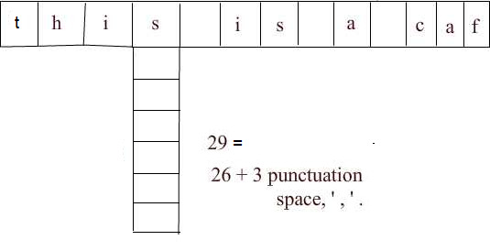
Input representation

Slide 35
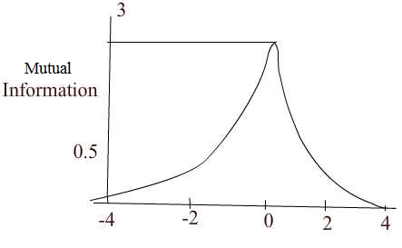
Network architecture
By a window of 7 characters, mutual information from a central character falls off rapidly in both directions as shown in the above figure.
Beyond 3 neighbors mutual information falls to less than 0.1.
Ref: Hetz et al, 1991

Slide 36
Training data
Phonetic transcription from informal continuous speech of a child
20,000 words from a pocket dictionary
Eg: phone f – o n –
A set of 1000 words were chosen form this dictionary; these are selected from the Brown corpus of the most frequent words in English.

Slide 37
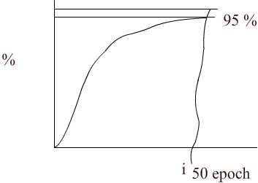
Learning curve
Found in human skill learning
Performance reaching about 95% correct after training the network with about 50,000 words.

Slide 38
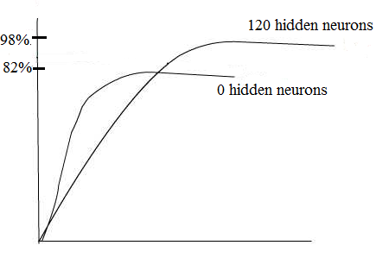
The presence of a hidden layer is found to be crucial to achieve this high level of performance. When a two-layer network (perceptron) was used for the same problem, performance quickly rose to 82% and saturated at that level.

Slide 39
Stages of learning
One of the first features learnt by the network is distinction between vowels and consonants
Next the network learnt to pause at word boundaries. Output resembled pseudo words with pauses between them.
After 10 passes text was understandable
Error patterns
Errors were meaningful. e.g thesis, these
The network rarely confused between vowels & consonants. Some errors actually were due to errors in annotation.

Slide 40
Test Performance
439 words from the regular speech. These words were not present in the training set.
Performance was at 78%. Thus the network demonstrated that it can generalize from one set of words to another.

Slide 41
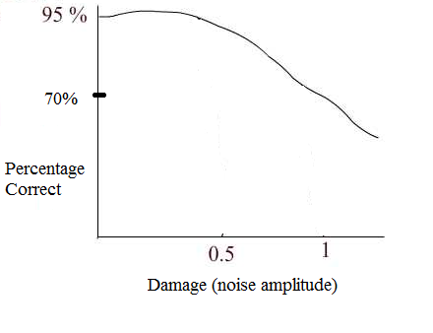
Damage testing
In order to test the robustness of the network in face of damage, random noise, n, uniformly distributed between -0.5 and 0.5 was added to each weight in the trained network.
The damaged network showed 67% performance.

Slide 42
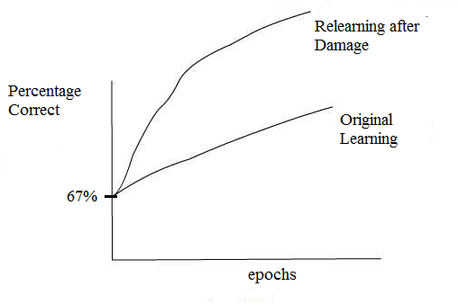
Relearning after Damage
Although the damaged network begins with the same performance level as the original network, it relearns the task much faster than the original network.

Slide 43
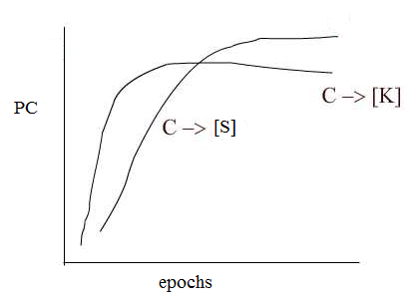
Specific letter-to-phoneme correspondences showed that different correspondences were learnt at different rates.
Soft ‘c’ (as in ‘nice’) takes longer to learn than hard ‘c’ (as in ‘cat’). This is probably because hard c occurs about twice as often as soft c in the corpus.
Interestingly children show a similar difficulty in learning.

Slide 44
Summary
Nettalk is a simple neural network model for converting text to speech
Nettalk can generalize to novel words
Traditional method depends on applying phonological rules and handling exceptions with a look-up table.
Highly labor intensive since each entry and rule must be hand-crafted.

Slide 45
Thank you!!!

